Slide 1

Presentation about: People counter
By Rojat

Slide 2

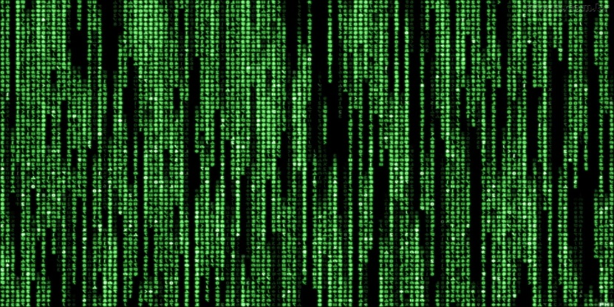
Contents
Project
What‘s a People Counter?
How does it work?
What if someone blocks it?
What‘s infrared light?
Why not another kind of sensor?
Demonstration
Summary
Questions
Imprint
Notes:
2

Slide 3


Project
It‘s a Project in the bbs
For technology lessons
It‘s Part of
Learning area 12.3
The personal goals are to
Work independently
Deal with compromise
Having a restricted budget
Create a project documentation
Learn more about the Arduino
1/10
Notes:
2010 laut BFM
Nominallohnsteigerung – Preissteigerung = Reallohnsteigerung
Nettolohn = Nominallohn = Bruttolohn – Lohnabzüge
Kaufkraftverlust führt zur Nachfrageverringerung und dadurch Wohlstandsminderung
3

Slide 4


What‘s a people counter?
Called click counter
Generally mostly Mechanical
Used to
Count readings
With a button
Button is pressed by hand.
It allows multiple readings
Used on events and for Research
2/10
Notes:
Zu den Personalzusatzkosten zählen alle Aufwendungen Der Arbeitgeber, welche für die Mitarbeiter neben dem reinen Arbeitsentgelt anfallen, auch als Lohnnebenkosten bezeichnet
Beispiel: max mustermann soll Techniker gehaltsvorstellung nennen. Am besten nicht zu hoch, da es im ausland viel günstiger möglich ist.
4

Slide 5
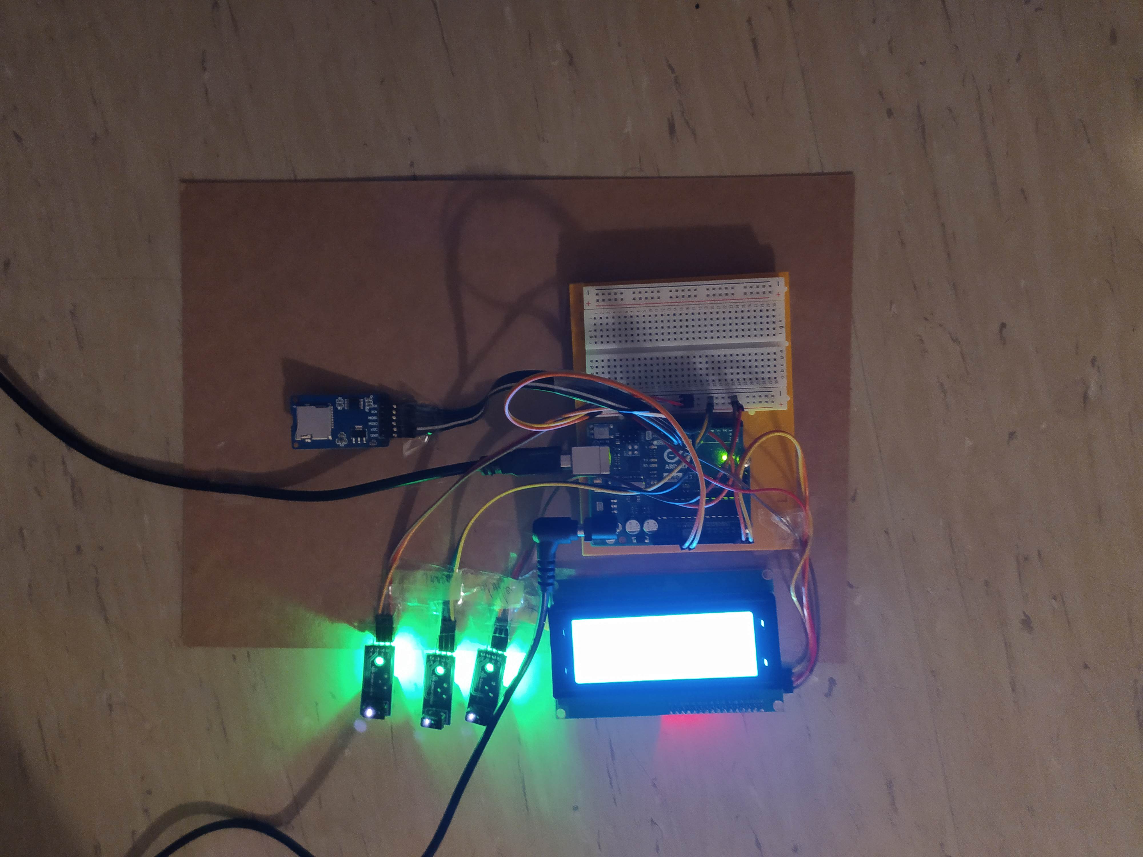


How does it work?
Sensors are used for the input
They work with Infrared light
By detecting motion.
Signal on movement detection
Sent to the arduino
Arduino analyzes data
Creates record on SD
Uses an LCD Display to
Output the amount of people
3/10
Notes:
5

Slide 6


What if someone blocks it?
If the outer sensors get blocked
Nothing happens
But when the Middle Sensor gets blocked
Arduino output error
On third line
It says „beweg dich“
Which is „move“ on english
The data gets recorded
And disappears when
Sensor no longer blocked
4/10
Notes:
2010 laut BFM
Nominallohnsteigerung – Preissteigerung = Reallohnsteigerung
Nettolohn = Nominallohn = Bruttolohn – Lohnabzüge
Kaufkraftverlust führt zur Nachfrageverringerung und dadurch Wohlstandsminderung
6

Slide 7


What‘s infrared light?
Part of physics
Electromagnetic radiaton
Can be described as sinus wave
It does create Heat
Just like the sun
IR is great for the skin
get darker skin
People counter is too weak
5/10
Notes:
2010 laut BFM
Nominallohnsteigerung – Preissteigerung = Reallohnsteigerung
Nettolohn = Nominallohn = Bruttolohn – Lohnabzüge
Kaufkraftverlust führt zur Nachfrageverringerung und dadurch Wohlstandsminderung
7

Slide 8
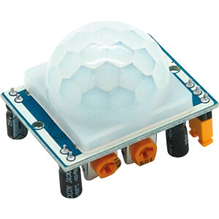
Why not another kind of sensor?
One option was PIR sensors
Stands for Passive infrared
They have a cooldown
They dont work in realtime
Didn‘t work when tested
Another were buttons
Work on press
Noone wants to press
i.e. corona
6/10
Notes:
2010 laut BFM
Nominallohnsteigerung – Preissteigerung = Reallohnsteigerung
Nettolohn = Nominallohn = Bruttolohn – Lohnabzüge
Kaufkraftverlust führt zur Nachfrageverringerung und dadurch Wohlstandsminderung
8

Slide 9

Demonstration
We‘re testing the counter
We‘ll count up
Wait for state change
Afterwards count down
Wait for state change
Then check recorded data
Via Excel
Create Diagram
Show after imprint
7/10
Notes:
2010 laut BFM
Nominallohnsteigerung – Preissteigerung = Reallohnsteigerung
Nettolohn = Nominallohn = Bruttolohn – Lohnabzüge
Kaufkraftverlust führt zur Nachfrageverringerung und dadurch Wohlstandsminderung
9

Slide 10
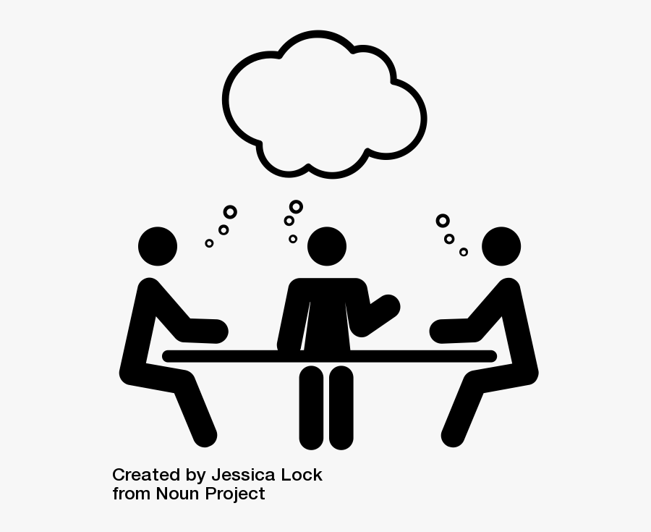

Summary
It‘s a school Project
As part of School
Part of technology lessons
Part of Learning area 12.3
Is a People counter
And is Arduino based
It has 3 Sensors
Works with Infrared
LCD for output
SD module for saving
8/10
Notes:
2010 laut BFM
Nominallohnsteigerung – Preissteigerung = Reallohnsteigerung
Nettolohn = Nominallohn = Bruttolohn – Lohnabzüge
Kaufkraftverlust führt zur Nachfrageverringerung und dadurch Wohlstandsminderung
10

Slide 11


Questions
Any questions?
If(questions==0){
next();
};
9/10
Notes:
2010 laut BFM
Nominallohnsteigerung – Preissteigerung = Reallohnsteigerung
Nettolohn = Nominallohn = Bruttolohn – Lohnabzüge
Kaufkraftverlust führt zur Nachfrageverringerung und dadurch Wohlstandsminderung
11

Slide 12
Imprint
https://www.bfs.de/DE/themen/opt/ir/einfuehrung/einfuehrung_node.html
https://de.wikipedia.org/wiki/Handz%C3%A4hler
https://de.wikipedia.org/wiki/Strahlung
https://de.wikipedia.org/wiki/Mechanik
Pir https://cdn-reichelt.de/bilder/web/artikel_ws/A300/HC-SR501_1.jpg
Title https://www.nicepng.com/png/detail/90-902051_clip-black-and-white-stopwatch-clipart-black-and.png brett https://media.istockphoto.com/vectors/project-management-icon-to-do-list-symbol-vector-id1175727223?k=6&m=1175727223&s=612x612&w=0&h=9RZaSsT3wnPeWHjBRDjfk6FiSMNeGLALBND8HM5na2o= goal https://www.clipartkey.com/mpngs/m/20-200954_clip-art-goals-clipart-black-and-white-goal.png
Click https://previews.123rf.com/images/giamportone/giamportone1712/giamportone171200057/91662195-click-hand-icon-with-black-outline-on-white-background.jpg
Button https://previews.123rf.com/images/arctina/arctina1806/arctina180600050/103754816-finger-push-button-flat-vector-icon-illustration-simple-black-symbol-on-white-background-finger-push.jpg
Sensor https://media.istockphoto.com/vectors/sensor-icon-vector-id926133126?k=6&m=926133126&s=612x612&w=0&h=H9c6dvp7Mrh-nE7IYGj_BZs0WgegKFvRXJvJhZICKl4=
Glas https://www.clipartkey.com/mpngs/m/133-1339215_black-and-white-icon-data-analysis-clipart-png.png
Outside https://lh3.googleusercontent.com/proxy/JvsKBefb6uS_8fyL-VrwHRdgfS3oGzTRxHcxncOiVw5UWumEXAZ5RvP34auXt9g_2Z5iWkY_xVSe3fw0Kph5-t9r0hqAun3wBUzCf9-CtHJkJBGc1vl3ZxrIGdArciKV4Cqn7ZBa-pH-tJPhaf52vifcY1udthkomw_zk8lBlWfmvhR3WYFGlw
Move https://thumbs.dreamstime.com/b/man-stands-walk-run-icon-human-movement-sign-vector-isolated-white-background-eps-196250374.jpg
Physic https://lh3.googleusercontent.com/proxy/X2_RL8lYfgoZ3sjOpbXb3N_Ib26vw_OmuXu4iYMeg7NGamDYJxe2YOGzMU5MeDJUnFq2FditW9-sagheR-CmEZs3e_t0_zU
Tanning https://www.clipartkey.com/mpngs/m/50-503916_beach-sunbathing-sun-tanning-svg-png-icon-free.png
Test https://www.clipartkey.com/mpngs/m/37-375972_test-clipart-survey-survey-clipart-black-and-white.png
Project https://www.clipartkey.com/mpngs/m/216-2166126_plan-for-positive-results-group-work-clipart-black.png
10/10
Notes:
2010 laut BFM
Nominallohnsteigerung – Preissteigerung = Reallohnsteigerung
Nettolohn = Nominallohn = Bruttolohn – Lohnabzüge
Kaufkraftverlust führt zur Nachfrageverringerung und dadurch Wohlstandsminderung
12

